Slide 1
Balazs Barcza
Student Number : SB18002
Final Project
Ger’s Garage

Slide 2
Project Overview
Ger is a mechanic who runs a small garage
  4 type of booking
  Invoice
  Booking status
Database
Website
Available in Cloud

Slide 3
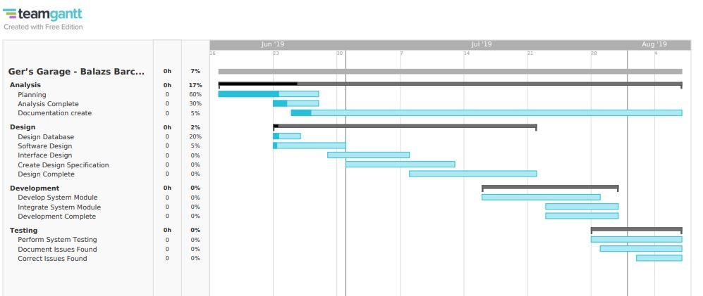
Teamgantt

Slide 4
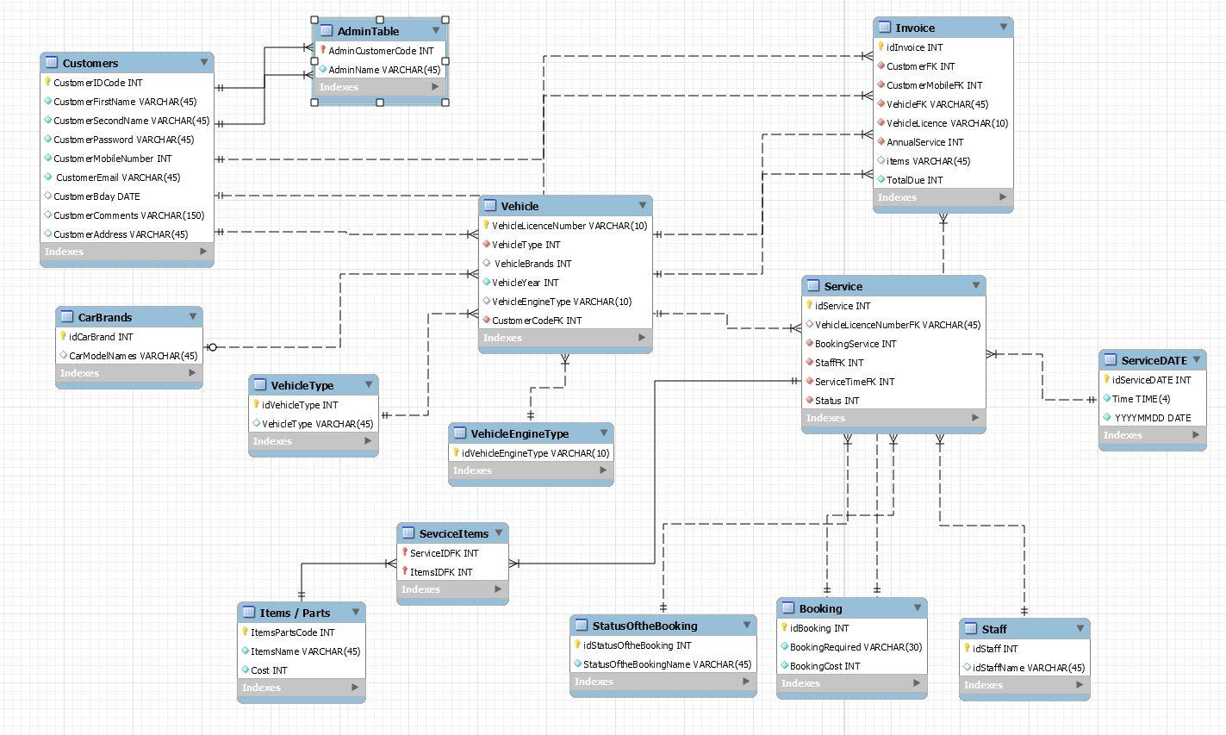
Database MySQL workbench

Slide 5
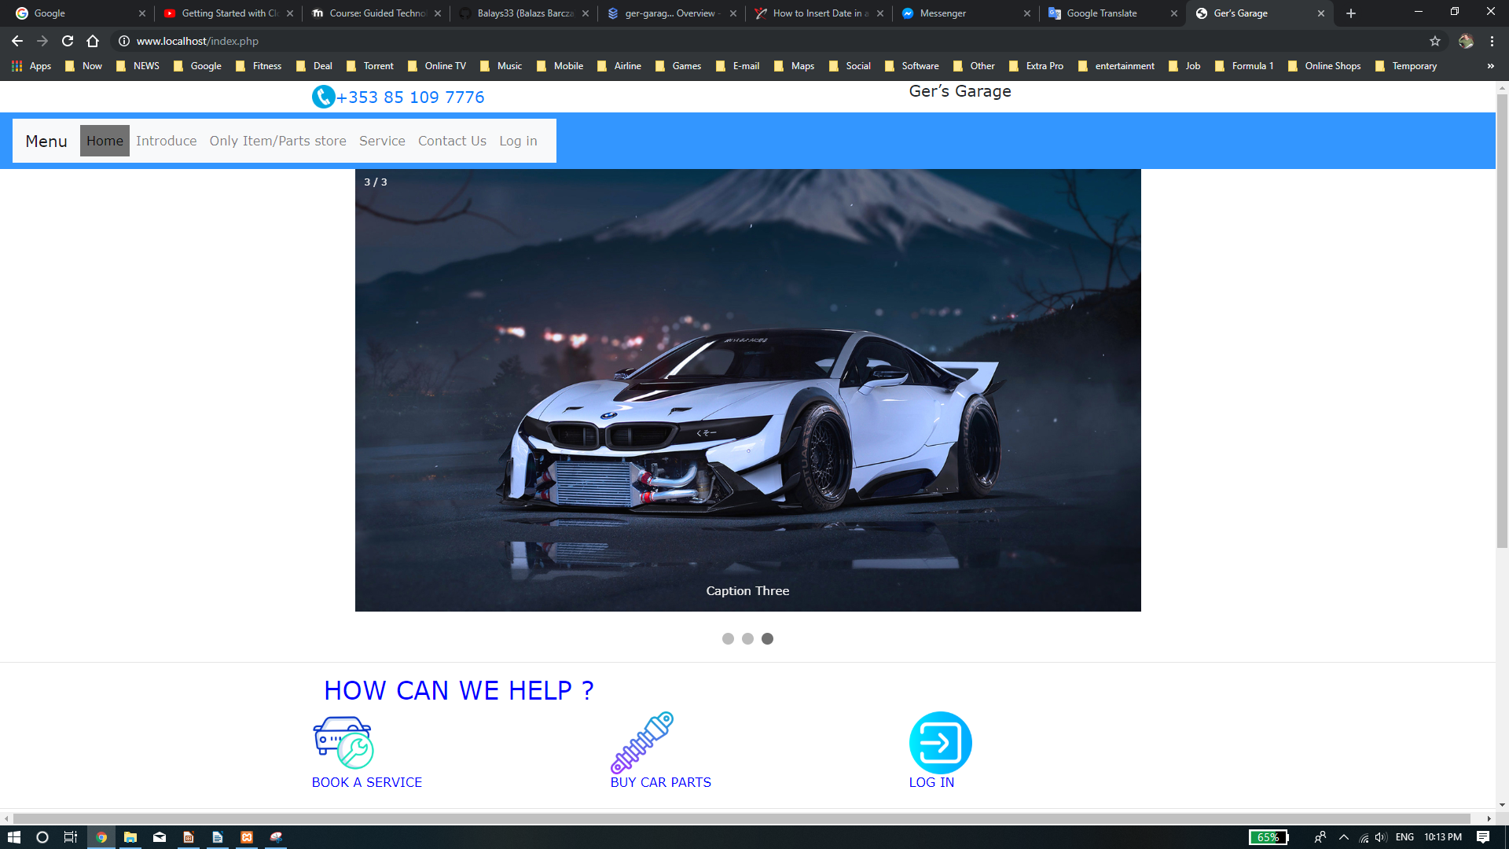
Website

Slide 6
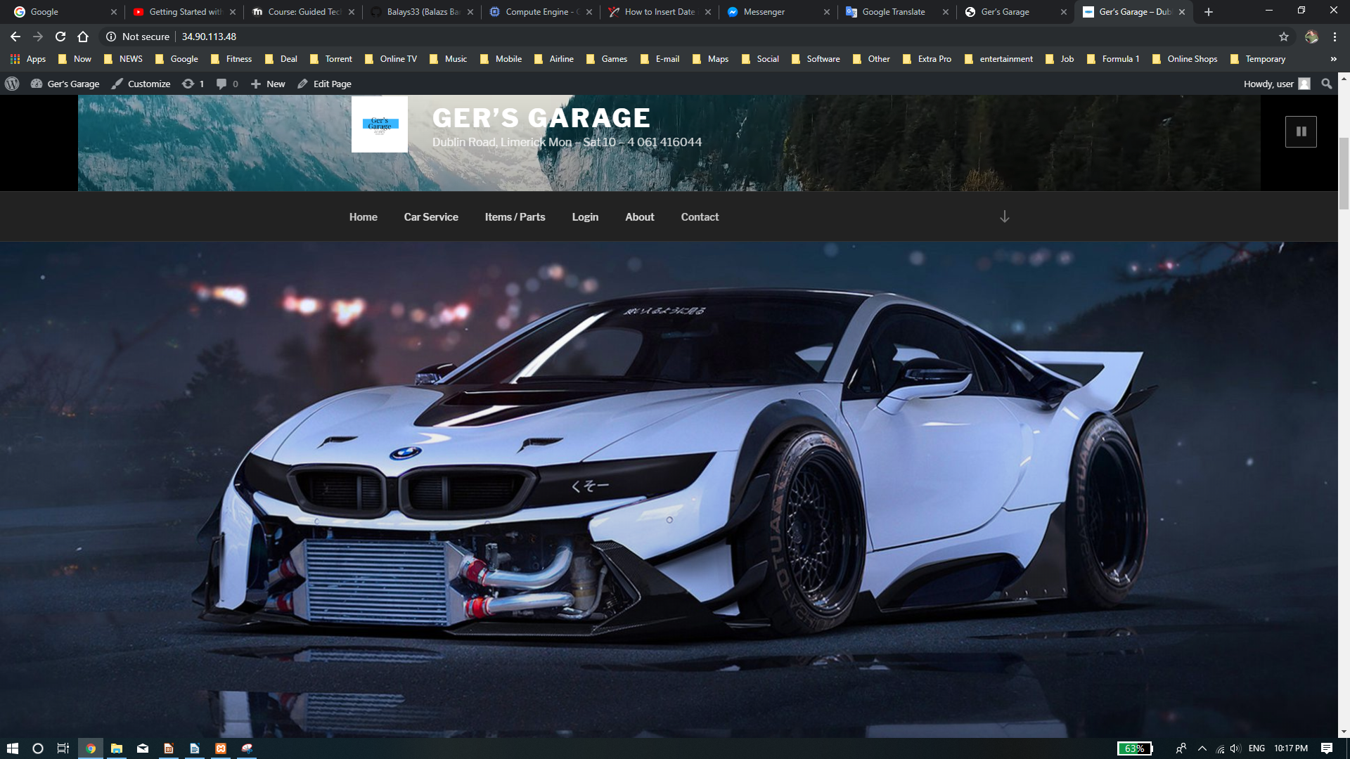
Website Wordpress

Slide 7
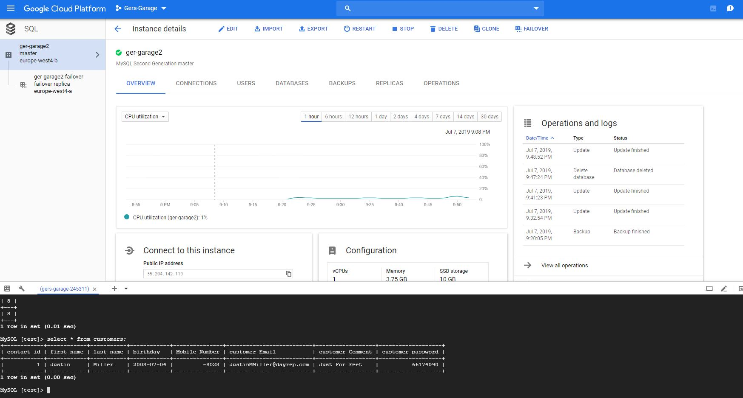
Google Cloud Platform SQL

Slide 8
Next steps
Log in system
Connecting with the database
Documentation
Move the service into the cloud

